Slide 1

THE LATEST BREAKTHROUGH EXPLAINED
Edge-AI Based Real-Time Violence Detection using ESP32-CAM
Venkat Bhavan Tati
Matrikel-Nr: 1575011
Industrial AI – Edge AI in Industrial Applications (AI5252) WiSe 25/26

Slide 2

Motivation & Problem Statement
VIOLENCE DETECTION IN INDUSTRIAL & PUBLIC ENVIRONMENTS
MANUAL SURVEILLANCE IS INEFFICIENT AND ERROR-PRONE
DELAYED HUMAN REACTION INCREASES SAFETY RISK
NEED FOR INTELLIGENT, AUTOMATED, REAL-TIME MONITORING

Slide 3

Project Objective
Develop distributed Edge-AI violence detection system
Binary classification: Violence vs Non-Violence
Real-time inference at edge
Remote access via mobile browser
GDPR-conscious architecture

Slide 4
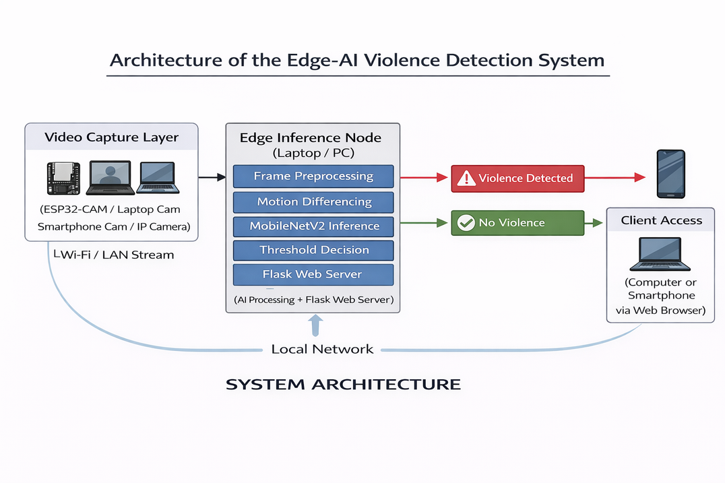
System Architecture
Video Capture Layer → ESP32-CAM / Laptop Cam / Smartphone Cam / IP Camera
Edge Inference Node → Laptop / PC (AI Processing + Flask Web Server)
Client Access → Computer or Smartphone via Web Browser
Communication → Local Network (Wi-Fi / LAN)

Slide 5
Problem
Edge-AI Solution
The pre-5G internet experience was slower and limited Manual surveillance is inefficient
Delayed response to violent incidents
Privacy risks in cloud-based systems
to certain spectrum types.
Edge sensing (ESP32-CAM)
Local AI inference
No cloud dependency
Real-time alert

Slide 6
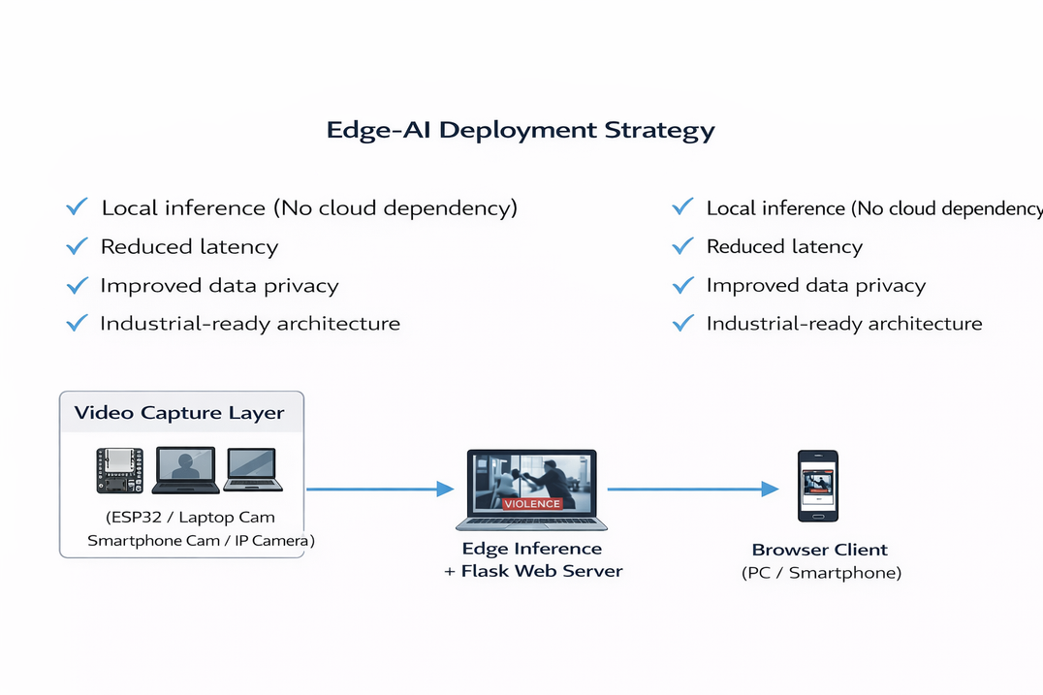
Edge-AI Deployment Strategy
Local inference (No cloud dependency)
Reduced latency
Improved data privacy
Industrial-ready architecture

Slide 7

AI Methodology
Binary classification problem
Motion-based frame differencing
MobileNetV2 lightweight CNN
Transfer learning applied
Instead of using raw frames directly, I compute motion information using frame differencing:
Motion at time t = |Frame(t) − Frame(t−1)|

Slide 8
MobileNetV2 Architecture
Depthwise separable convolutions
Reduced computational cost
Suitable for edge environments
96×96 grayscale input
Sigmoid output (violence probability)

Slide 9

Inference Pipeline
Grayscale Conversion
Convert RGB frame to grayscale to reduce computational complexity.
Resize (96 × 96)
Resize frame to match model input dimensions.
Normalization
Scale pixel values for stable and efficient inference.
CNN Forward Pass
Feed processed frame into MobileNetV2 model.
Threshold Decision
Apply sigmoid probability threshold to classify:
Violence or Non-Violence.
Overlay & Display
Display prediction result on video stream via Flask web interface.

Slide 10

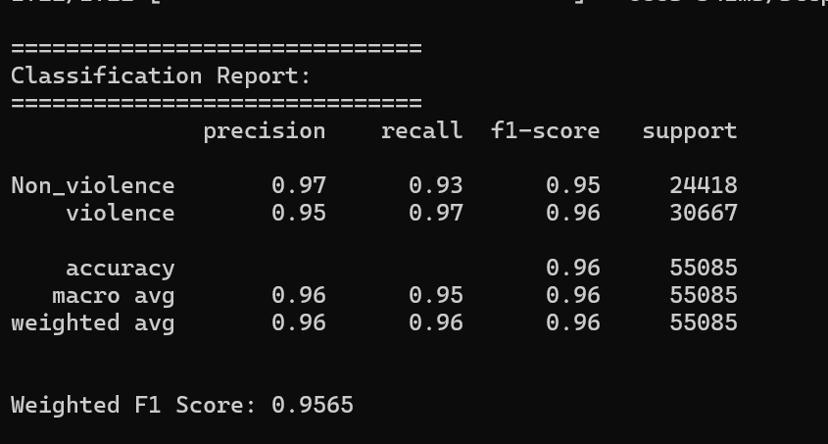
Performance Metrics
PERFORMANCE METRICS
Accuracy: 96%
Precision (Violence): 0.95
Recall (Violence): 0.97
Weighted F1-Score: 0.9565

Slide 11
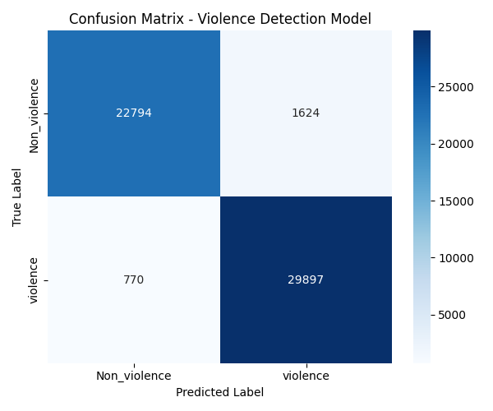
Confusion Matrix
CONFUSION MATRIX
29,897 violent samples correctly classified
Low false negative rate
Safety-critical performance

Slide 12

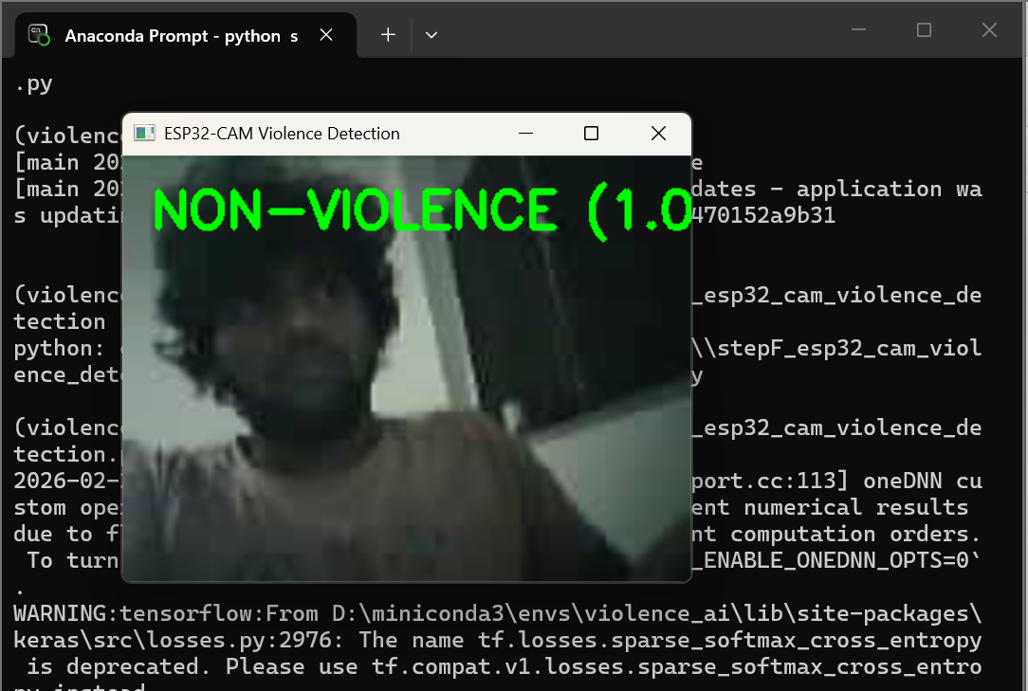
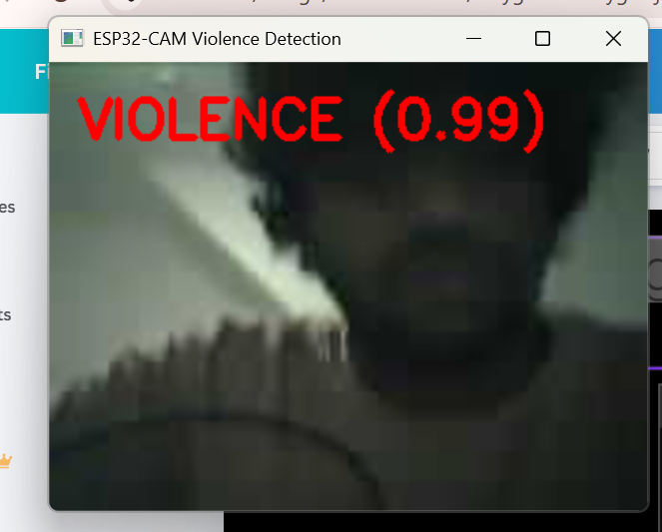
Detection using esp32 cam

Slide 13
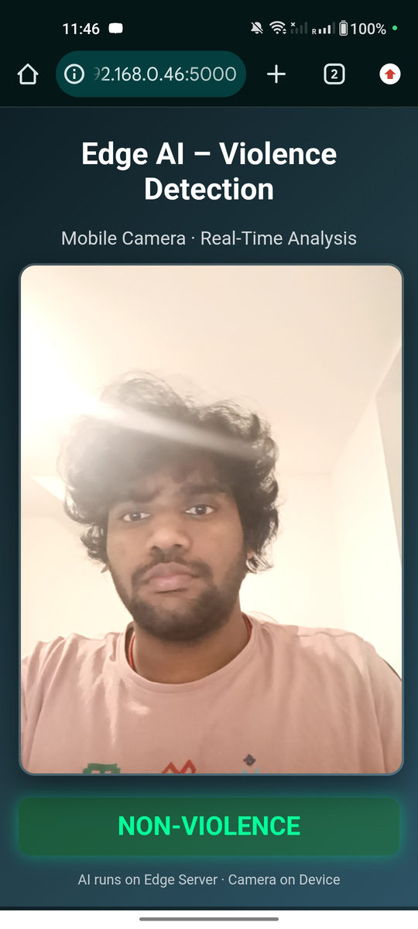
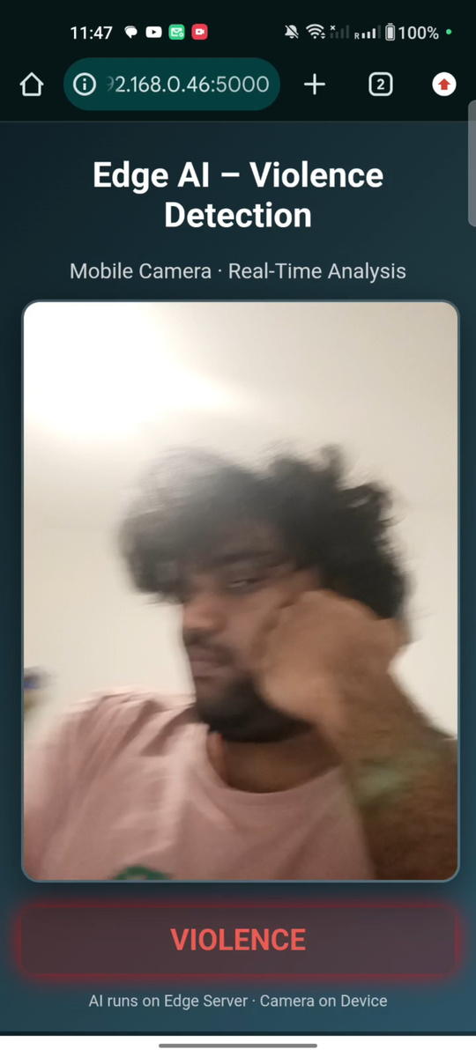
Detection using phone(flask web server)

Slide 14
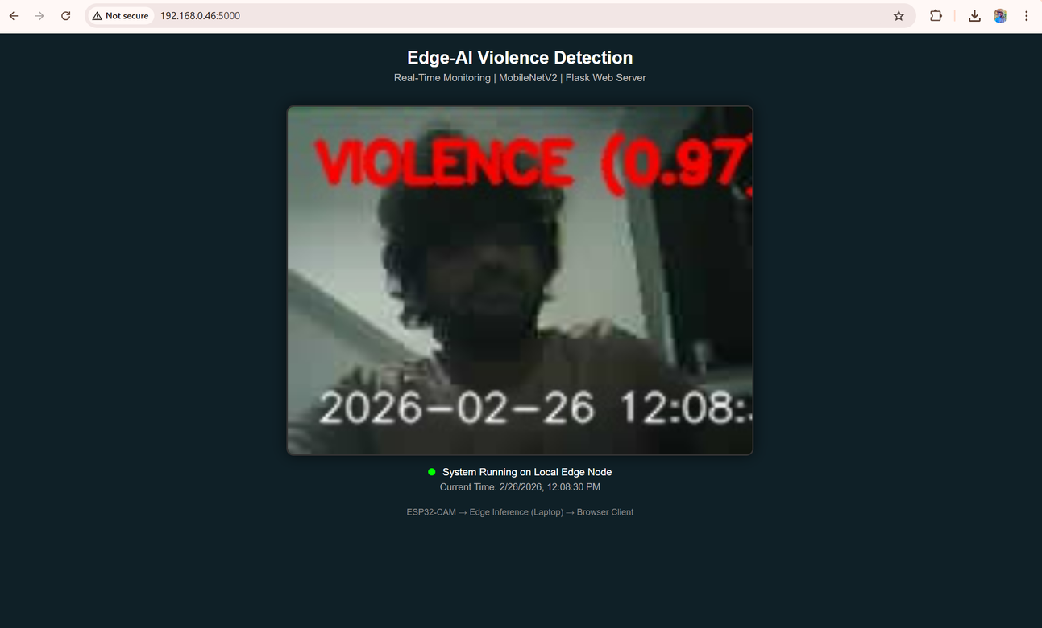
Detection using esp32 cam(flask web server)

Slide 15
GDPR & PRIVACY COMPLIANCE
GDPR & Privacy Compliance
No video storage
No cloud transmission
No biometric identification
Local network processing
Privacy-by-design architecture

Slide 16

Why Direct TensorFlow Implementation?
CUSTOM MOTION PREPROCESSING
FULL ARCHITECTURAL CONTROL
FLEXIBLE DEPLOYMENT
INDUSTRIAL WORKFLOW ALIGNMENT

Slide 17
Limitations & Future Work
MOTION SENSITIVITY
ESP32 WI-FI LATENCY
DATASET DIVERSITY
FUTURE: WEAPON DETECTION
FUTURE: TEMPORAL MODELING

Slide 18
Conclusion
DISTRIBUTED EDGE-AI ARCHITECTURE
REAL-TIME VIOLENCE DETECTION
MULTI-DEVICE ACCESSIBILITY
GDPR-CONSCIOUS SYSTEM
INDUSTRIALLY SCALABLE

Slide 19

Do you have
any questions?
Send it to us! We hope you learned something new.

